Slide 1
Chapter 7
Chapters
1. Introduction
2. Graphs
3. Descriptive statistics
4. Basic probability
5. Discrete distributions
6. Continuous distributions
7. Central limit theorem
8. Estimation
9. Hypothesis testing
10. Two-sample tests
13. Linear regression
14. Multivariate regression
Sampling Distribution and
Central Limit Theorem

Slide 2
What is the Mean Diameter of a Cherry
1. Take a sample, measure their diameters and get the mean.
What do we have? Is it the mean diameter of the population? Is it close to the population mean?
2. Take another sample with same sample size get the sample mean.
Do we have anything new? Is it the same as the first? Is it the population mean? Is it close to?
3. Take sample after sample, with the same sample size, calculate mean after mean.
What do we have? Data for the sample mean.

Slide 3
Another Thought
Suppose 3 cherries are drawn and diameters are measured. We have three observations of a random variable, each of which comes from the same distribution. Call them d1, d2 and d3.
Sample mean is ‾X=1/3*d1+1/3*d2+1/3*d3
Linear Combination of R.V.s ! X-bar is R.V., too!
X-bar has its own distribution, called “Sampling Distribution” of the mean.
Then we can work out the mean and standard error (the standard deviation of the sampling distribution) for X-bar using formula from linear combination.

Slide 4


1 Sampling Distribution of averages
Throw a fair die,
Random variable X = # of spots on any throw.
The probability distribution of X is:
…and the mean and variance are calculated as well:
x | 1 | 2 | 3 | 4 | 5 | 6
P(x) | 1/6 | 1/6 | 1/6 | 1/6 | 1/6 | 1/6

Slide 5
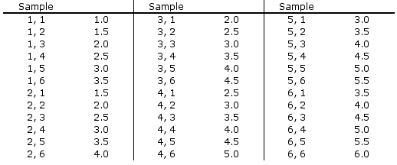

Throw a Die Two Times
36 possible samples of size 2, only 11 values, and some occur more frequently than others.

Slide 6



Sampling Distribution of Two Dice…
The sampling distribution of is shown below:
P( )
6/36
5/36
4/36
3/36
2/36
1/36
P( )

Slide 7

Compare…
Compare the distribution of X…
…with the sampling distribution of .
As well, note that:

Slide 8


Generalize…
We can generalize the mean and variance of the sampling of two dice:
…to n-dice:
The standard deviation of the sampling distribution is called the standard error:

Slide 9
Central Limit Theorem…
The sampling distribution of the mean of a random sample drawn from any population is approximately normal for a sufficiently large sample size.
The larger the sample size, the more closely the sampling distribution of X-bar will resemble a normal distribution. In many practical situations, a sample size of 30 may be sufficiently large.
However, if the population is normal, then X-bar is exactly normal for all values of n.

Slide 10


Sampling Distribution of the Sample Mean
1.
2.
3. If X is normal, X is normal. If X is non-normal, X is approximately normal for sufficiently large sample sizes.
Note: the definition of “sufficiently large” depends on the extent of non-normality of x (e.g. heavily skewed; multimodal)
Approximations become “good” once n ≥ 30.

Slide 11
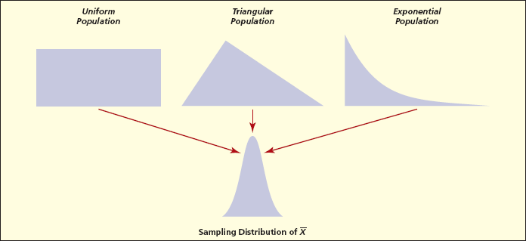
Central Limit Theorem

Slide 12
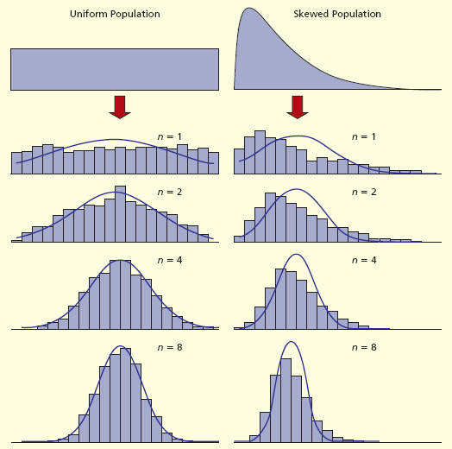
Central Limit Theorem

Slide 13
Example
The foreman of a bottling plant has observed that the amount of soda in each “32-ounce” bottle is actually a normally distributed random variable, with a mean of 32.2 ounces and a standard deviation of 0.3 ounce.
If a customer buys one bottle, what is the probability that the bottle will contain more than 32 ounces?
If a customer buys a carton of four bottles, and measure the mean amount of the four bottles . Will it be 32.2?
Suppose the customer gets a mean of 32, is it the population mean? What is the probability that the mean amount of the four bottles will be greater than 32 ounces?

Slide 14



Example
We want to find P(X > 32), where X is normally distributed with =32.2 and =.3
Things we know:
X is normally distributed, therefore so will X.
= 32.2 oz.

Slide 15
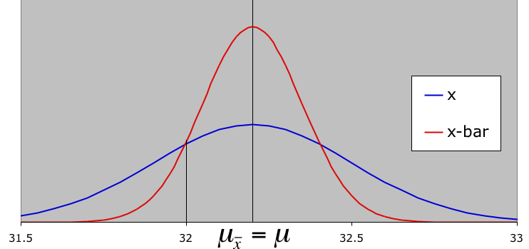
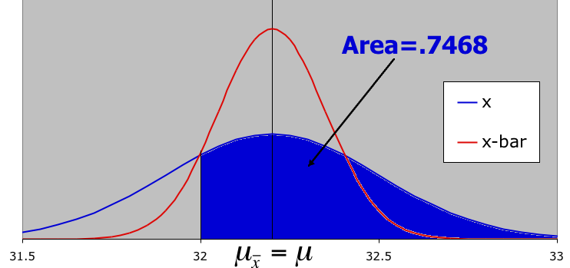
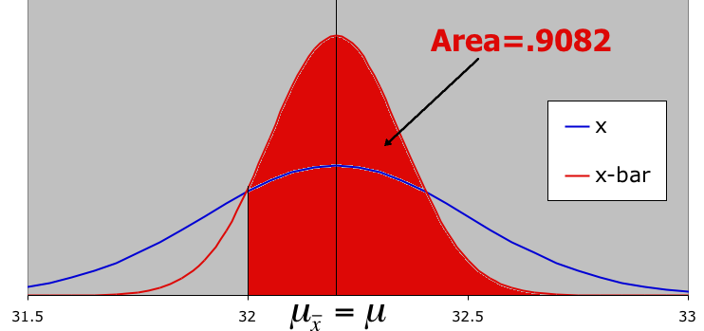
Graphically Speaking…
mean=32.2
what is the probability that one bottle will contain more than 32 ounces?
what is the probability that the mean of four bottles will exceed 32 oz?

Slide 16
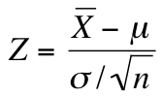
Standardizing the Sample Mean…
The sampling distribution can be used to make inferences about population parameters.
In order to do so, the sample mean can be standardized to the standard normal distribution using the following formulation:

Slide 17
Sampling Distribution of a Proportion…
The estimator of a population proportion of successes is the sample proportion. That is, we count the number of successes in a sample and compute:
X is the number of successes, n is the sample size.
P can be any value between 0 and 1, so is continuous variable.
Enable us to transform categorical variables into quantitative variables.
P is the sample version of , just like X-bar is the sample version of
When and

Slide 18
Example: Sample Proportions
Suppose the proportion of voters that support the Democratic party in the US is 52%.
Randomly select a voter. What is the probability that a Democrat is selected?
What is the probability of selecting a sample of 100 voters, in which the proportion of Democrats is:
Equal to 55%
Less than 50%
Between 40% and 52%

Slide 19
Answers
Since proportion of Dems is 52%, the chance to pick a Democrat in a random draw is 52%.
Can proportion be assumed normally distributed?:
0.52*100 = 52 >= 5
0.48*100 = 48 >= 5
Then p ~ N(0.52, sqrt((0.52*0.48) / 100))
P(p=55%) = 0
P(p<=50%) = NORM.S.DIST((0.50-0.52)/ 0.04996,1)
P(40%<=p<=52%) = NORM.S.DIST((0.52-0.52)/0.04996,1) – NORM.S.DIST((0.40-0.52)/0.04996,1)

Slide 20

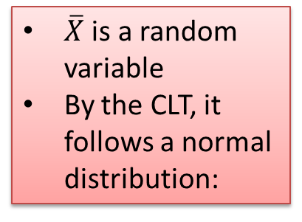

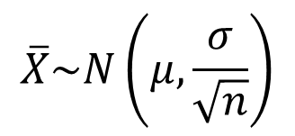


Summary CLT: sample averages
Population
Sample 1: n = 60
$$\overline{x_{1}}$$
Sample 2: n = 60
$\overline{X}$ is a random variable
By the CLT, it follows a normal distribution:
Random variable X has unknown distribution:
$$\overline{x_{2}}$$
….
$$X\sim ?(μ,σ)$$
$$\overline{X}\sim N\left(μ,\frac{σ}{\sqrt{n}}\right)$$
Sample 100: n = 60
$$\overline{x_{100}}$$
if n>30

Slide 21





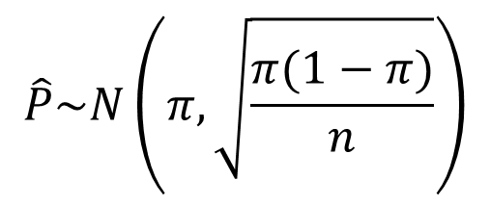
Summary CLT: sample proportions
Population
Sample 1: n = 60
$${\hat{p}}_{1}$$
Sample 2: n = 60
$\overline{X}$ is a random variable
By the CLT, it follows a normal distribution:
True population proportion :
$$π$$
$${\hat{p}}_{2}$$
….
$$\hat{P}\sim N\left(π,\sqrt{\frac{π(1−π)}{n}}\right)$$
Sample 100: n = 60
$${\hat{p}}_{100}$$
if: $$n∗π≥5$$
$n∗(1−π)≥5$

